Slide 1

Wireless Network
By-
Dr. Jesmin Akhter
Professor
Institute of Information Technology
Jahangirnagar University

Slide 2
Contents
The course will mainly cover the following topics:
Wireless Networking
Multiple Access techniques
FDMA, TDMA and CDMA systems
Modulation Techniques
Analog and digital modulation techniques, Performance of various modulation techniques - Spectral efficiency, Error rate
The Cellular Concepts and System Design Fundamentals
Cellular concept and frequency reuse, Channel assignment and handoff, Interface and system capacity, Trunking and Erlang capacity calculations
Mobile Radio Propagation
Radio wave propagation issues in personal wireless systems, Propagation models, Multipath fading, Parameters of mobile multipath channels, Antenna systems in mobile radio.
Cellular Wireless Networks
Principles of Cellular Networks
First-Generation Analog
Second-Generation TDMA
Second-Generation CDMA
Third-Generation Systems

Slide 3
Outline
Cellular Wireless Networks
Principles of Cellular Networks
First-Generation Analog
Second-Generation TDMA
Second-Generation CDMA
Third-Generation Systems

Slide 4
CELLULAR OPERATION:
Cellular network organization uses low power transmitter(100W or less).The areas are divided into cells. Each cell is served by its own antenna and a base station consisting of transmitter, receiver, and control unit.
There are three basic devices they are:
• A mobile station(MS)
• A base transceiver Station(BS)
• A Mobile Telecommunications Switching Office (MTSO)
Base station include an antenna, a controller, and a number of receivers.
Base station is at center of each cell. Base station is connected to MTSO. One MTSO serve as multiple Base station. The link between MTSO to BS is by wire or wireless.MTSO connects calls between mobile units and from mobile to fixed telecommunications network .It assigns voice channel and performs handoffs and monitors calls (billing).

Slide 5
CELLULAR OPERATION:
Two channels are available between mobile unit and BS, they are:
1. Control channel: They are used to exchange information and perform setup and maintaining calls. It establishes a relationship between Mobile unit and nearest BS.
2. Traffic channel: It carries voice or data connection between users.
Public Land Mobile Network (PLMN) refer to a cellular network that has land and radio based sections.

Slide 6
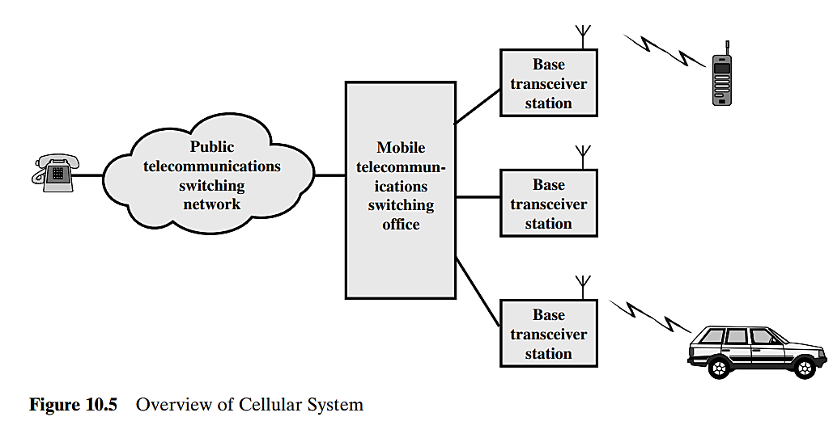

Slide 7
CELLULAR OPERATION:
This network consist of:
• Mobile station (MS) is a device used for communication over the network.  
• Base station transceiver (BST) is a transmitter/receiver that are used to transmit/receive signals over the network.
• Mobile switching  center (MSC) is used to Sets up and maintain calls made over the network.
• Base station controller (BSC) which provides a Communication between a group of BSTs and a single MSC is controlled by the BSC
• Public switched telephone network (PSTN) Consist of Section of the network that is land base.

Slide 8
CELLULAR OPERATION:
Steps in MTSO controlled call connecting mobile units:
1. Mobile unit initialization scans and choose strongest set up control channel and automatically pick up a BS antenna of cell. Handshake is used to spot user and register location. Scan is recurring to allow for movement of change of cell.
2. Mobile originated call check if the set up channel is free and Send number on pre-selected channel.
3. In Paging MTSO attempts to connect to mobile unit. Depending on called mobile number the paging message will be sent to BSs. By using the setup channel Paging signal is transmitted.

Slide 9
CELLULAR OPERATION:
4. In call accepted, the Mobile unit recognizes the number on the set up channel and responds to BS which in turn send response to MTSO. Then the MTSO sets up a circuit between calling and called BSs and select a available traffic channel within cells and notifies BSs. The BSs notify mobile unit of channel.
5. In Ongoing call the Voice/data is exchanged through respective BSs and MTSO.
6. If the signal strength decreases as the mobile moves out of range from BTS it is called handoff. And the traffic channel changes to the one assigned to new BS.

Slide 10
CELLULAR OPERATION:
Other Functions:
1. Call blocking: On mobile-initiated call stage, if all the traffic channels are busy, the mobile tries again and again. After numeral retries, a busy tone will be returned.
2. Call termination: The User will hang up, MTSO is informed and the traffic channels at two BSs are released.

Slide 11
CELLULAR OPERATION:
3. Call drop: If the BS cannot maintain a required signal strength then call drop will occur and the traffic channel is dropped and MTSO informed.
4. Calls to/from fixed and remote mobile subscriber: Here the MTSO connects to PSTN and can connect to mobile user and fixed subscriber via PSTN. MTSO can also connect to remote MTSO via PSTN or via dedicated line.

Slide 12
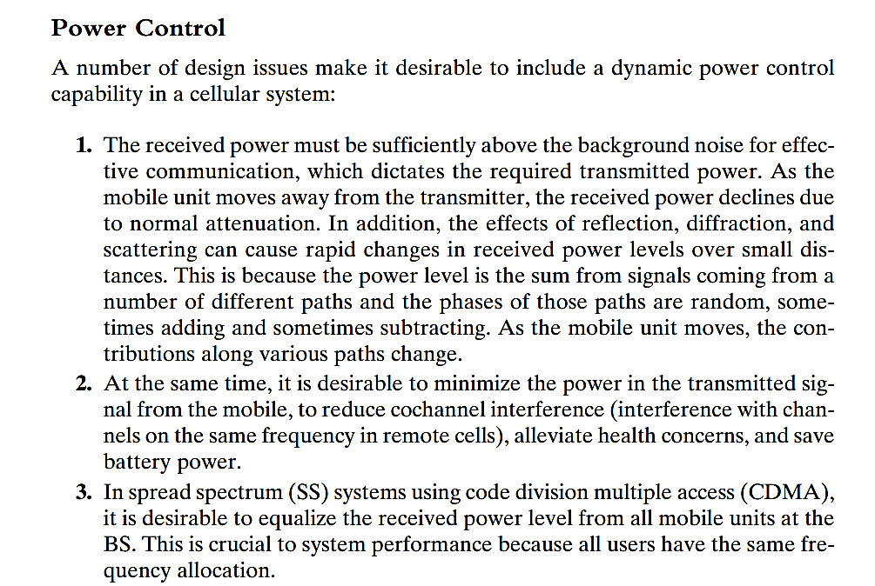

Slide 13
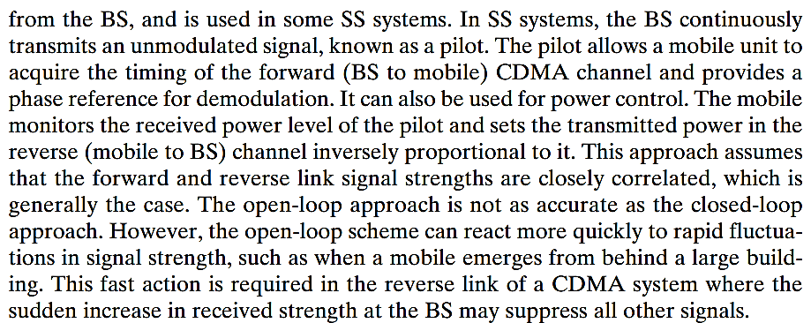

Slide 14
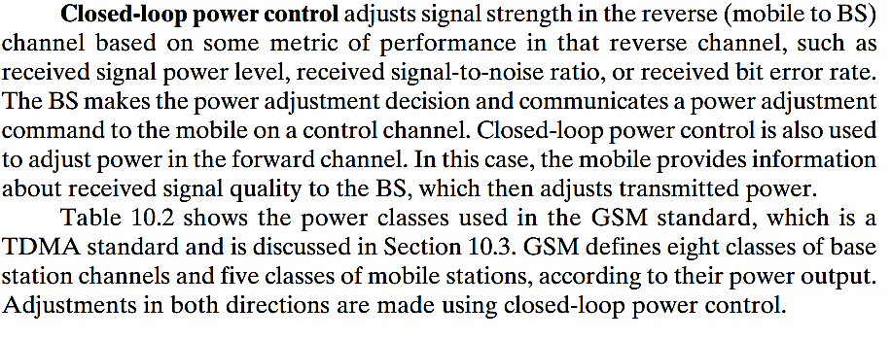

Slide 15
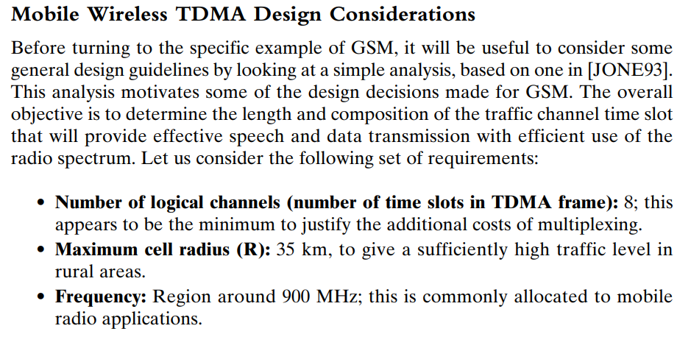

Slide 16
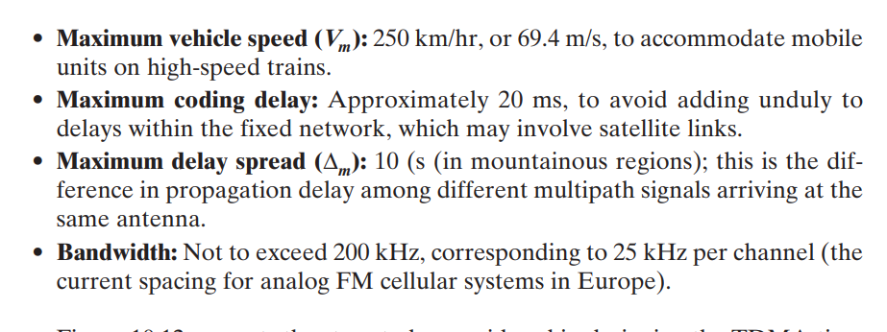

Slide 17
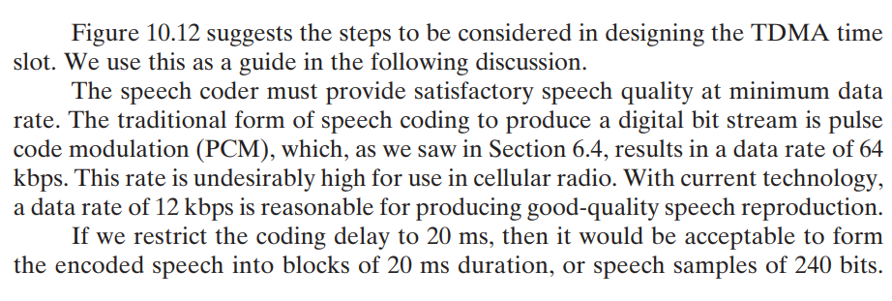

Slide 18
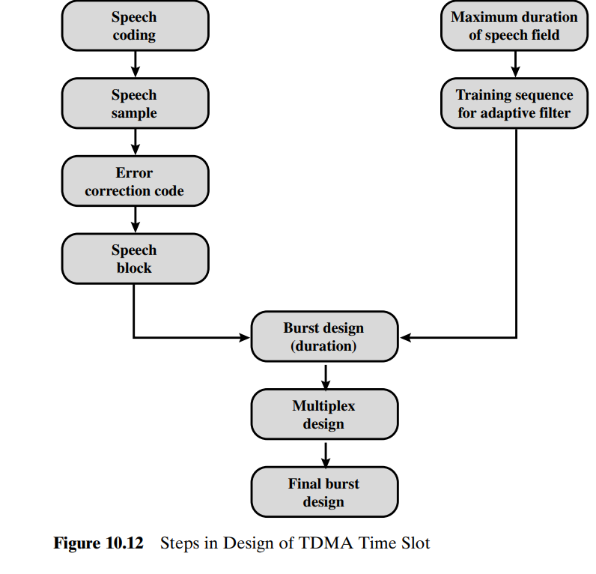

Slide 19
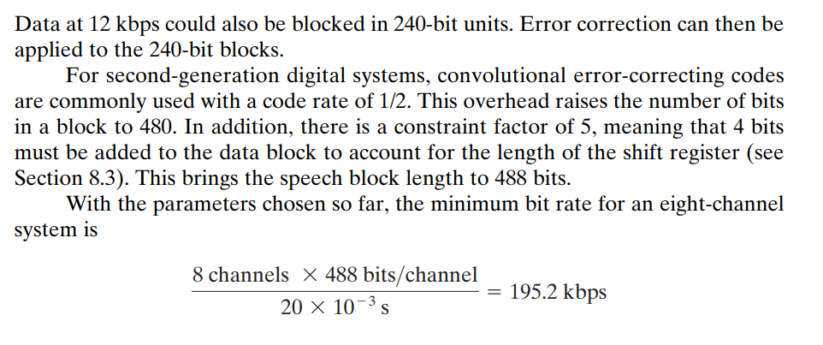

Slide 20
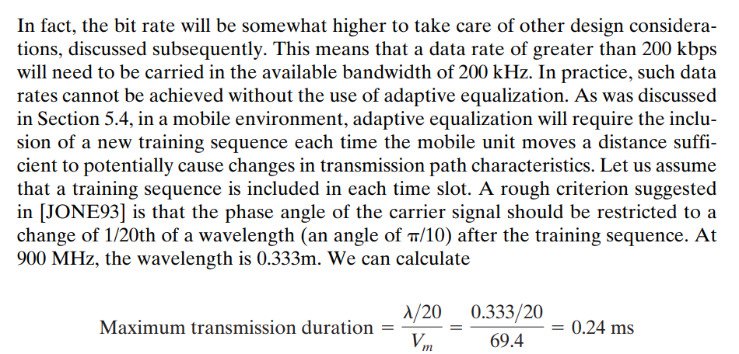

Slide 21
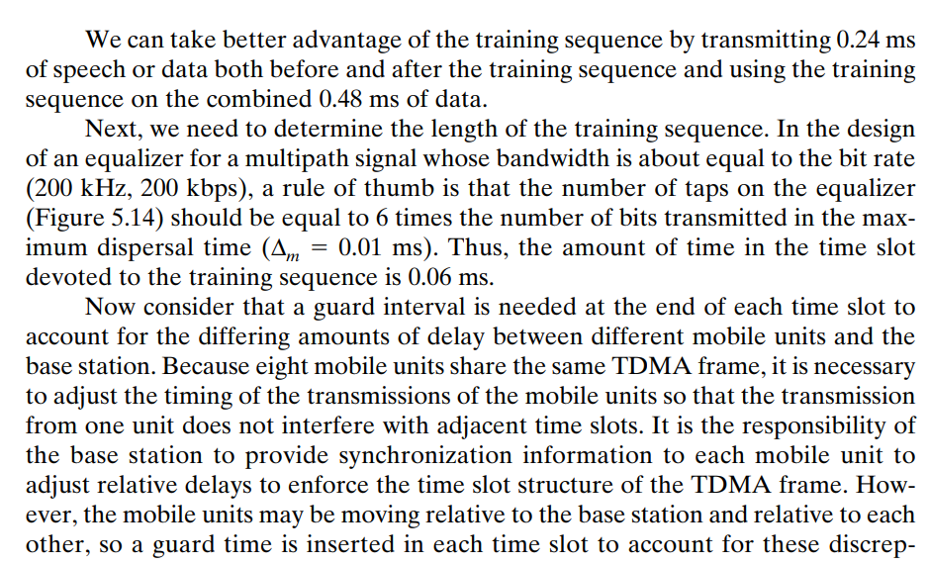

Slide 22
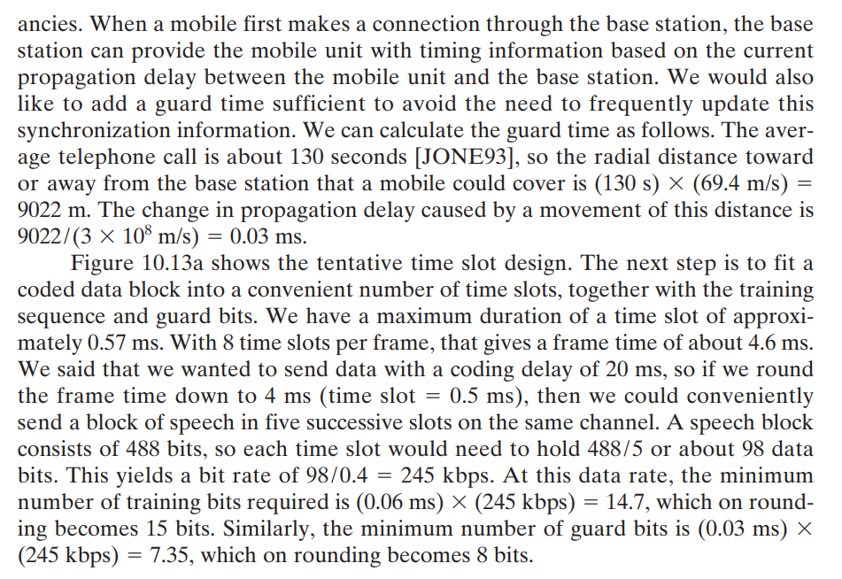

Slide 23
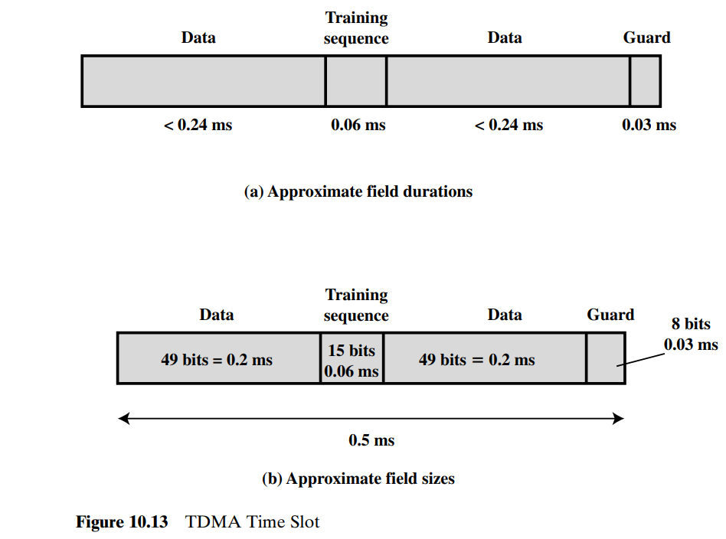

Slide 24
Popular 2G Systems
GSM
CDMA
EDGE Enhanced Data rates for GSM Evolution
GPRS General Packet Radio Service

Slide 25
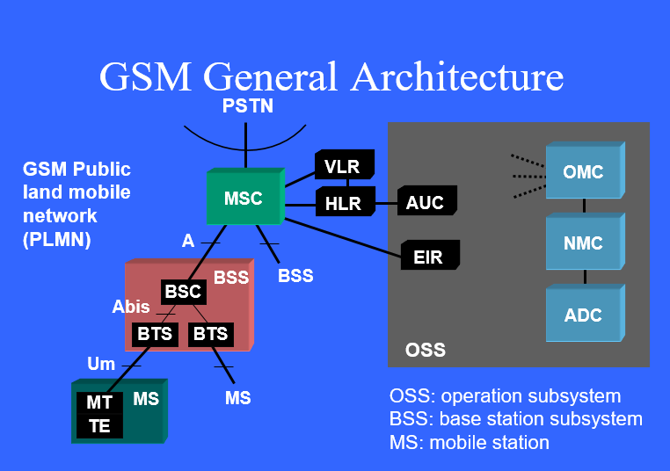
Mobile station (MS)
• Base transceiver station (BTS)
• Base station controller (BSC)
• Mobile switching center (MSC)
• Authentication center (AuC)
• Home location registers (HLR)
• Visitor location registers (VLR)
Notes:
Mobile station (MS)
• Base transceiver station (BTS)
• Base station controller (BSC)
• Mobile switching center (MSC)
• Authentication center (AuC)
• Home location registers (HLR)
• Visitor location registers (VLR)
Mobile Station;
The mobile station (MS) is the starting point of a mobile wireless network. The MS can contain the following components:
• Mobile terminal (MT)—GSM cellular handset
• Terminal equipment (TE)—PC or personal digital assistant (PDA)
The MS can be two interconnected physical devices (MT and TE) with a point-to-point interface or a single device with both functions integrated
OMC- Operations and Maintenance Centre
NMC- Network Management Centre

Slide 26
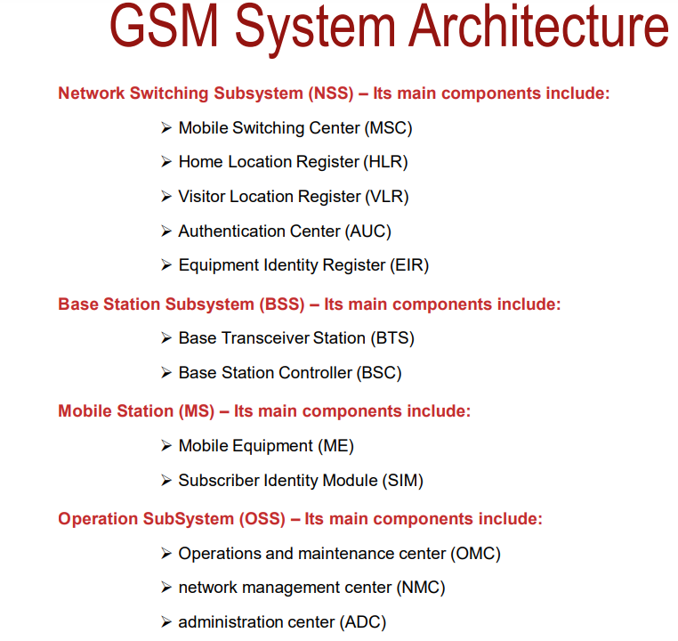

Slide 27
Home Location Register (HLR) represents a centralized database that has the permanent datafill about the mobile subscribers in a large service area (generally one per GSM network operator).
The HLR is kept updated with the current locations of all its mobile subscriber, including those who may have roamed to another network operator within or out side the country. The routing information is obtained from the serving VLR on a call by call basis.
The Visiting Location register (VLR) represents a temporary data store and there is one VLR per MSC. This register contains information about the mobile subscriber who are currently in the service area covered by the MSC/VLR. VLR includes:
Features currently activated
MS identity
Current location

Slide 28
Authentication Center (AUC): Generally associated with the HLR, the authentication center contains authentication parameters that are used on initial location registration, subsequent location updates and on each call set-up request from the MS.
In GSM , protection from unauthorized access is achieved through strong authentication procedures that validate the true identity of subscriber before he or she is permitted to receive service.
The authentication and ciphering functions in GSM are closely linked and are performed as a single procedure between MS and the network.

Slide 29
An authentication algorithm A3, a cipher key generation algorithm A8 and an encryption algorithm A5, individual subscriber authentication key (Ki) are also programmed into the MS at the time of service provisioning. The relevant call flows are shown in fig.1
5
4
3
5
4
3
BSC
MSC
3 4 5
4 3
VLR
MS
1 2
SIM with A3, A5, A8, Ki
HLR

Slide 30
VLR sends IMSI (International Mobile Subscriber Identity) to the HLR.
HLR returns security triplets (RAND, SRES, Kc) to the VLR
For authentication and ciphering the VLR sends RAND to the MS.
Using stored A3 algorithm and secret key Ki stored in the SIM, and RAND provided by the VLR the MS calculates SRES (Signed Response) and returns it to the VLR. Using the A8 algorithm and Ki, The MS also calculates the cipher key Kc.
If the SRES returned by the MS matches with the stored SRES in the VLR, the VLR sends the cipher key Kc to the BTS which uses Kc for ciphering the radio path (down link)
MS uses its Kc to cipher the radio path (uplink) using encryption algorithm)
5
4
3
5
4
3
BSC
MSC
3 4 5
4 3
VLR
MS
1 2
SIM with A3, A5, A8, Ki
HLR

Slide 31
Equipment Identity Register (EIR): The EIR maintains information to authenticate terminal equipment so that fraudulent, stolen on non-type-approved terminals can be identified and denied service.

Slide 32
Popular 3G Systems
UMTS- Universal Mobile Telecommunications System
CDMA 2000
HSPDA-High-Speed Downlink Packet Access
EVDO- Evolution-Data Only

Slide 33
Popular 4G Systems
WiMAX
Long Term Evolution (LTE)

Slide 34
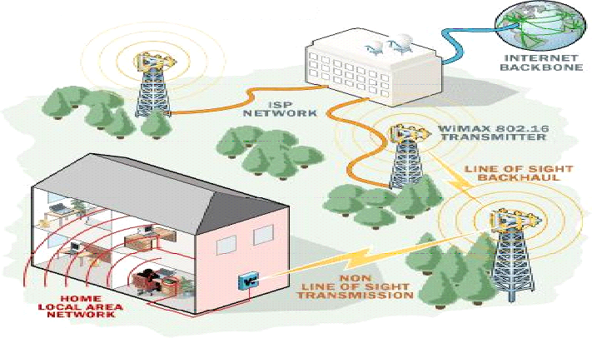
WiMAX
Wi-MAX : The Worldwide Interoperability for Microwave Access, is a technology aimed at providing wireless data over long distances It is based on the IEEE 802.16 standard.
Fig.1

Slide 35
Some important features of WiMAX
OFDM in physical layer: The access technique used in physical layer of WiMAX is OFDM; where the high speed serial data is converted to low rate parallel streams and each stream is modulated by separate carrier each one is known as subcarrier. Subcarriers are mutually orthogonal and deals with low data rate hence can protect multipath fading.
Very high peak data rates: The data rate of WMAX is 70Mbps under the channel of bandwidth of 20 MHz. The rate can be further increased using space division multiplexing i.e. incorporation of multiple antennas.

Slide 36
Some important features of WiMAX
Adaptive Modulation and Coding: The IEEE 802.16e standard changes modulation and channel coding scheme based on received SNR. For example a SS close to the BS can use a high modulation scheme (more bits per symbol) i.e. the system can get more capacity but when the SS is at the cell boarder the system permits lower modulation scheme (increased signal space on orthogonal basis function coordinate system) to avoid huge symbol error rate. Therefore the system can overcome the time selective fading (the channel condition is better at some instant than other).
Error Correction Techniques: WiMAX incorporates two types of strong error correction techniques: FEC (Forward Error Correction) for multimedia traffic and ARQ (Automatic Repeat Request) for data traffic to improve throughput.
Support for TDD and FDD: Like mobile cellular communication it supports both FDD (Frequency division duplexing) and TDD (Time division duplexing), as well as a half-duplex FDD. Above features provide the flexibility of using same or different carriers for up and down link.

Slide 37
Long Term Evolution (LTE)
Long-term evolution (LTE) standard is one of the newly developed fourth generation (4G) standards for mobile communications. In the standard, either frequency division duplexing (FDD) or time division duplexing (TDD) schemes can be used to achieve two-way communications.

Slide 38
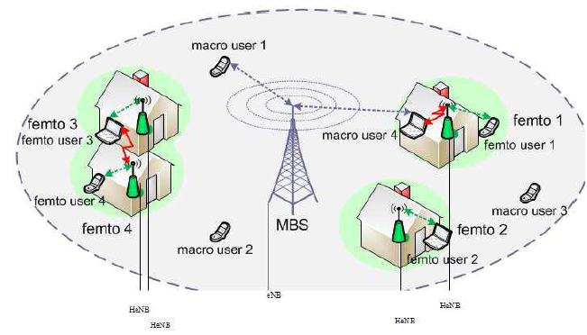
Features of LTE
The LTE- Advanced (Long Term Evolution- Advanced) is 4G wireless service proposed by 3GPP (Third generation Partnership Project). In 2009 4G LTE started its commercial service in Scandinavia. Three important features of LTE are: femtocell deployment , OFDMA-based physical layer access and MIMO.
The FBS (Femto BS) is named as Home evolved Node-B (HeNB) in LTE-A placed in public places to provide higher data rate and improve resource usage to a number of users. Femtocells are different in the sense that they are installed by customers in an ad hoc fashion without any RF planning. Objective of eNodeB Femtocells lies in off-loading of traffic.

Slide 39
Comparison of 3G and 4G
3G | 4G
Data Rates of 100 Kbps to 2 Mbps Goal is 'to provide multimedia multirate mobile communications anytime and anywhere'. Connection between the cellular world and the wired Internet firmly established. Mobile devices used mainly for Human-to-Human and Human-to-Machine communication | Data Rates up to 100 Mbps Expansion on the 3G goal to provide a wider range of new and improved multimedia services. Integration of broadcast, cellular, cordless, Wireless LAN, short-range and fixed wire systems to appear as a single seamless network. Not only the 3G modes of communication but also characterized by a great deal of Machine-to-Machine traffic

Slide 40
Thank You

